Slide 1
Introducing SharePoint Framework
Paul Galvin
Galvin.paul@gmail.com
@pagalvin

Slide 2
Agenda
About the speaker
What is SharePoint Framework?
What do you need to use it?
Create a web part
Deploy the web part
Resources

Slide 3
About the speaker
Paul Galvin
Slalom Consulting
@pagalvin on the twitter machine
https://medium.com/@pagalvin

Slide 4
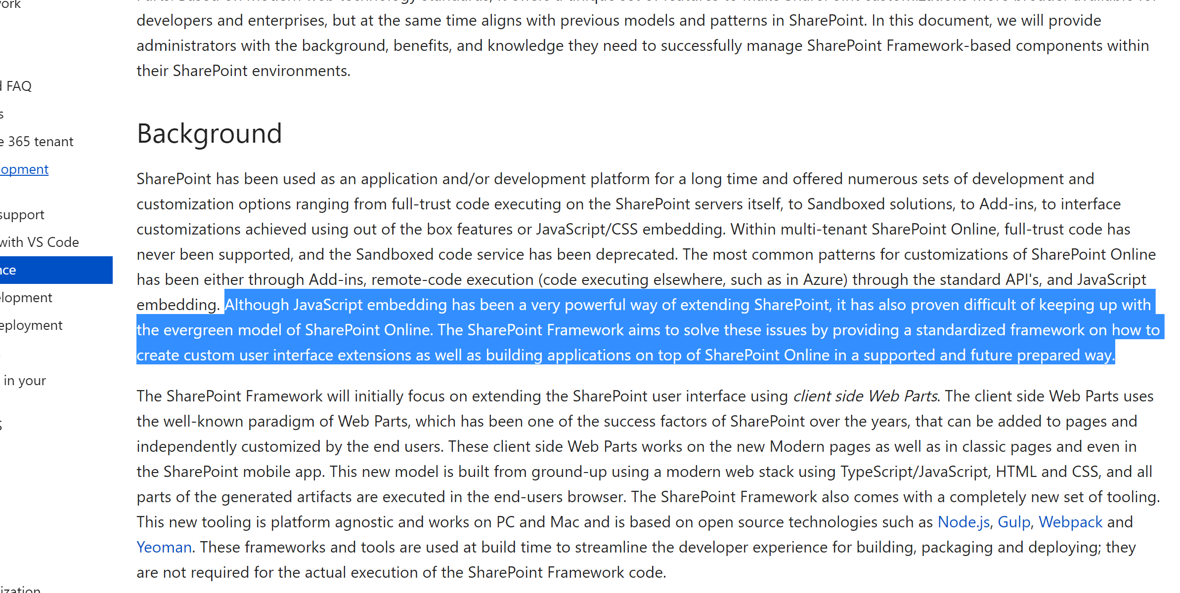
What is SharePoint framework?
Although JavaScript embedding has been a very powerful way of extending SharePoint, it has also proven difficult of keeping up with the evergreen model of SharePoint Online. The SharePoint Framework aims to solve these issues by providing a standardized framework on how to create custom user interface extensions as well as building applications on top of SharePoint Online in a supported and future prepared way.

Slide 5
What is SharePoint framework
Released in late Feb this year
Microsoft’s foray in modern web tooling for SharePoint
Node and Npm: installing dependencies, req’s for gulp, webpack and other bits
Yoeman: Scaffolding for your app – builds an empty ready-to-go web part
Webpack: smart bundler for client-side solutions
Gulp: task runner – compiles, deploys code for you
TypeScript: strongly typed JavaScript. The best thing since peanut butter and chocolate.
Frameworks: React seems to have the best support today
Initially (and today): web parts for modern UI sites and classic web pages
Works with SharePoint online and SP 2016 on-prem, feature pack 2

Slide 6
Getting started with Spfx
App catalog site.
Dev site collection (any template will do, not limited to “dev” template).
Node “LTS” version (“Long Term Support”). I used 6.9.5 preparing for this talk.
Yoeman and gulp (scaffolding and task runner).
Code editor.
VS Code is well-supported and commonly used.

Slide 7
Video demo: Configure the environment in five easy steps!
Let’s watch a short video
Install NodeJS
Install Yeoman
Install gulp
Install Yeoman SharePoint generator
Not demonstrated:
VS Code
Cmdr (my replacement command line application)
Step by step: https://docs.microsoft.com/en-us/sharepoint/dev/spfx/set-up-your-development-environment
Notes:
Didn’t want to show this live since it’s boring and potentially time-consuming.

Slide 8
What did we just see?
Much of the configuration is done just once
Download Node, Yoeman, gulp only one time
Use Yoeman to generate web part scaffolding for every web part

Slide 9
Demo: Running the workbench
From command line: “gulp serve”
Fires up the local workbench
Disconnected from SharePoint
Fast and easy Edit/Save/Test cycle
Notes:
After showing the slide, pull up the workbench and show it. Add the web part to the page.

Slide 10
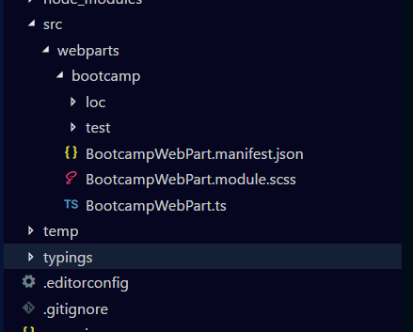
Demo: Review the Project Structure
“src” directory is where all the good stuff is
We get:
Manifest json file
Scss file styling
One TS file for web part logic
Notes:
After showing this slide, pull up the project in vs code and show the project structure.

Slide 11
Demo: Adding a new Property
Add a multi-line text property and show on the screen
Steps:
Edit the IBootcampWebPartProps interface
Update the getPropertyPaneConfiguration() method
Update the html in the render() method.
Notes:
After showing this slide, pull up the project and add in the multi-line description.
I have this ready to go in the project if needed.

Slide 12
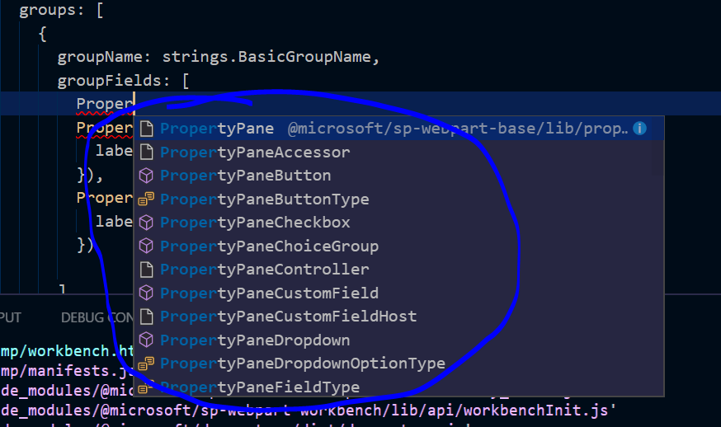
Notes on properties
There are a lot of different kinds of properties you can add.
This demo is showing properties “live” (reactive). You can add an “apply” button here easily.
Notes:
Explain that there are a lot of good options for new property types.

Slide 13
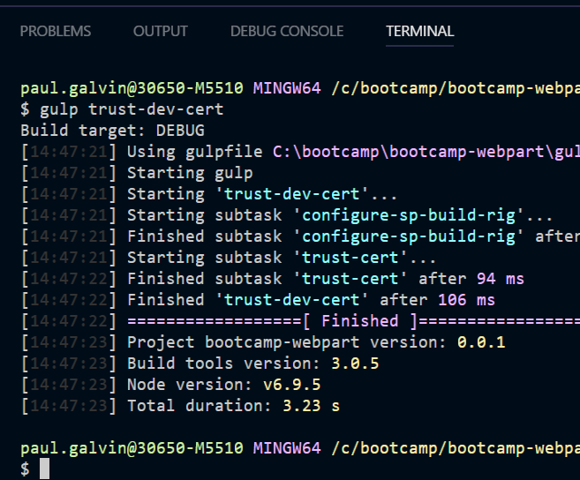
Demo: deploying to SharePoint – part 1
You can still use the workbench
Located at [site]/_layouts/workbench.aspx
In this first demo, webpart assets are served to SharePoint via your local machine
Run this command to enable it:
gulp trust-dev-cert
“gulp serve” must be running
Notes:
When working in the “local” workbench, you’re not actually connected to SharePoint. Therefore, you can’t access any data. This next demo shows that you can access data.
In the next step, run gulp trust-dev-cert

Slide 14
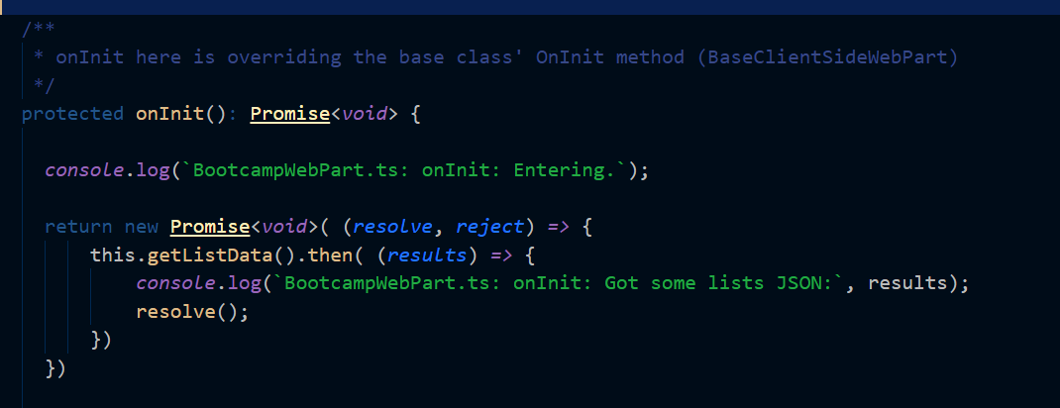
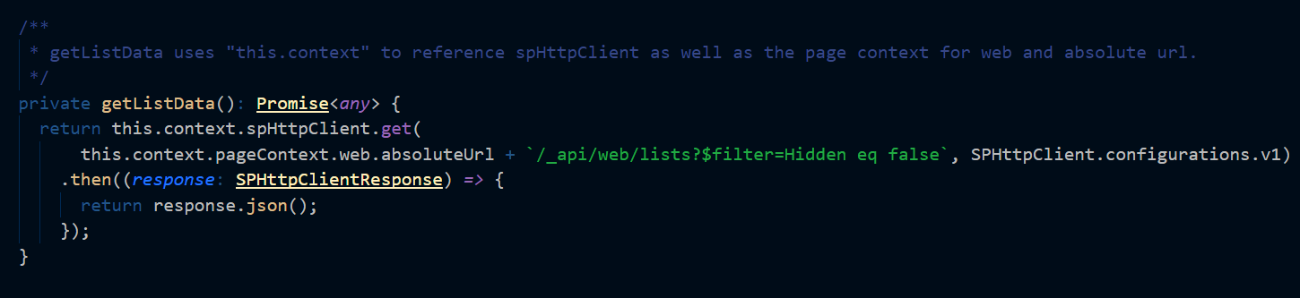
Demo: Retrieving content via rest
Web part can use all the normal REST APIs
Microsoft provides some helpers:
SPHttpClient
SPHttpClientResponse
Notes:
Switch away and do the demo of the rest api

Slide 15
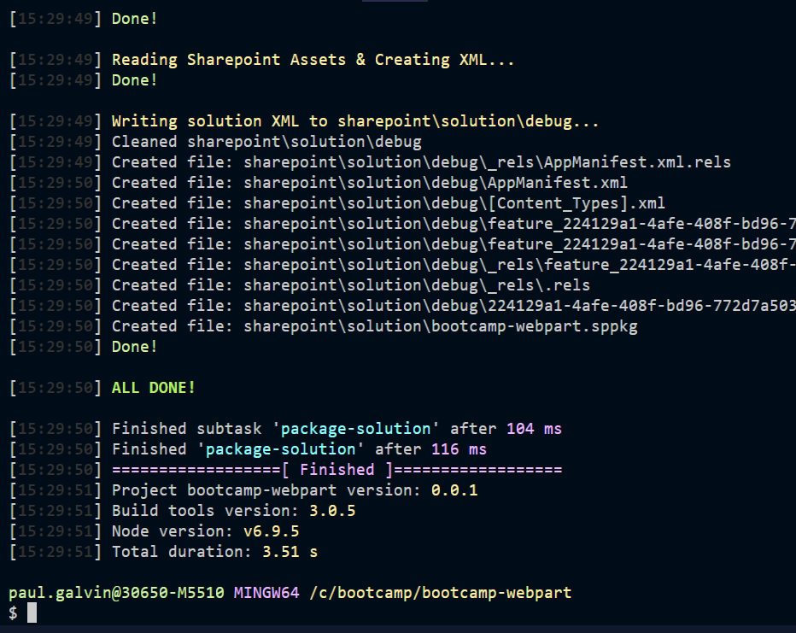
Demo: Deploy to SharePoint part 2
Use gulp to create a solution package
“sppkg” file (internally zip)
Command “gulp package-solution”
Upload to app catalog
Add it to a site via gear icon -> Add an app
Notes:
In the command window, run “gulp package-solution”
Open up windows explorer
Drag it into the app catalog

Slide 16
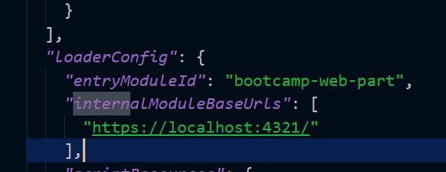
Demo: run the app in sharepoint
At this point, the “app” is in SharePoint, but its assets are still being pulled from your local host machine
Run gulp serve and test it out
gulp serve –nobrowser
No local workbench, just the server
Notes:
Run “gulp server –nobrowser”

Slide 17

Demo: deploy to SharePoint part 3
We still need to get the web part assets up “somewhere” so that the JavaScript can be served to browsers that request it
App catalog doesn’t have the code
Microsoft wants you to use Azure CDN for some reason
We’ll host in a SharePoint library

Slide 18
Deploy to SharePoint steps
Decide where you want to save your assets
Update the write-manifiest.json to point there
Use gulp to create “shippable” code: “Gulp –ship”
This creates a few files under “temp\deploy”
Since we changed write-json, we need to re-package as well and upload:
Gulp package-solution –ship
Upload to the app catalog again (replace)
Upload these to your doc library
Notes:
Save in a CDN? Save in SharePoint?
I’ve already updated write-manifest.json

Slide 19
Recap
Lots of new tools
Node, npm, webpack, etc. But they are all common client-side dev stuff.
TypeScript! New programming language, but very easy to learn if you already know JS or especially C#/Java.
Web parts fully supported
Add them to pages, arrange them.
They can use REST APIs and do amazing things.
They have real property panes!
Deployment can be complex, but doesn’t have to be.

Slide 20
About Angular
Typescript seems to be pegged at version 2.4.2 or something like that
This interferes with Angular 2+, sadly

Slide 21
Next steps
Book Learning
Go home and read the docs (see resources at end).
Activate
Follow the hello, world web part tutorial
Share
Blog about your experience.

Slide 22
resources
SPfx announcement: https://blogs.office.com/en-us/2017/02/23/sharepoint-framework-reaches-general-availability-build-and-deploy-engaging-web-parts-today/
Install pre-requisites: https://docs.microsoft.com/en-us/sharepoint/dev/spfx/set-up-your-development-environment
Uploading / using Azure CDN: https://docs.microsoft.com/en-us/sharepoint/dev/spfx/web-parts/get-started/deploy-web-part-to-cdn

Slide 23
Thank you!
Please log your feedback:
https://aka.ms/o365devbootcampfeedback

